Slide 1
Plugin Name
SpyderScience.Nop.Plugin.Scheduler
Id | CustomerId | Status
1 | 43 | 1
2 | 54 | 0
SP_OnlineOfflineStatus
SP_Schedule
Id | Name | CustomerId | VisibileToCustomers | LimitedToStore | LimitedToWarehouse | ScheduleType | UtcTime | Published
1 | ABC | 231 | 123;234;231 | Store1 | Warehouse1 | 1
2 | DEF | 213 | 213;43;234 | Store2 | Warehouse2 | 2
SP_Schedule_DateRange
Id | ScheduleId | StartDate | EndDate
1 | 1 | DD/MM/YYYY | DD/MM/YYYY
SP_Schedule_Time
Id | scheduleId | DateRangeId | WeekDay | StartTime | EndTime
1 | 1 | 1 | Monday | HH:MM:SS | HH:MM:SS
Id | EntityName
1 | Product
2 | Category
3 | Manufacture
4 | Customer
SP_SchedularEntityFilteration
SP_Schedule_Mapping
Id | EntityNameId | ScheduleId | EntityId
1 | 1 | 1 | 20
2 | 2 | 1 | 24
3 | 1 | 1 | 304
Id | ScheduleType | EntityOption
1 | 1 | 1
2 | 1 | 1;2
3 | 1 | 1;2
4 | 1 | 2
SP_Schedule_Option

Slide 2
Product Schedule

Slide 3
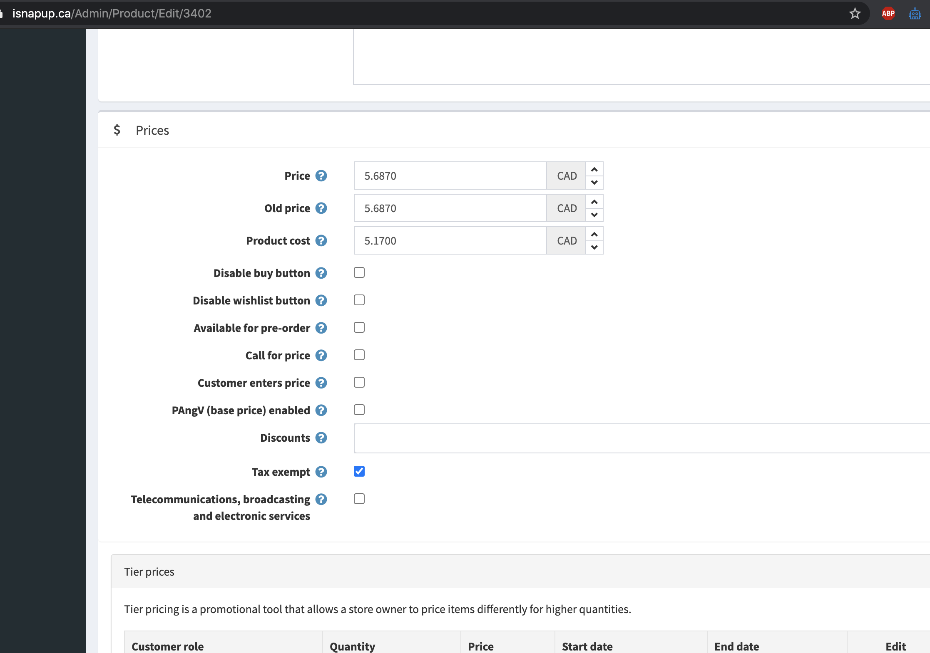
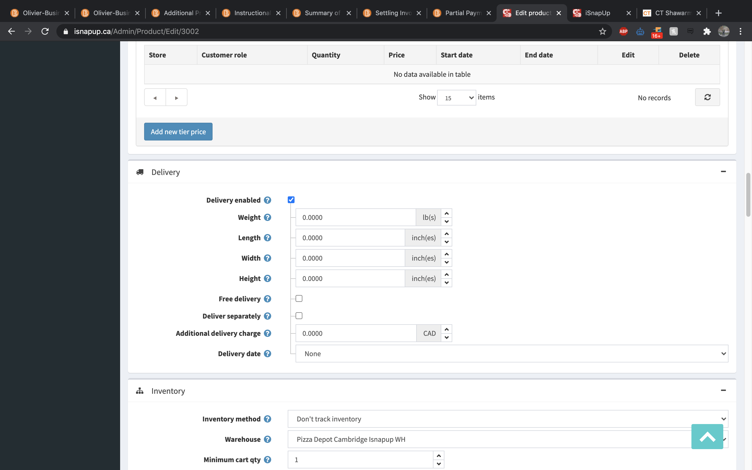
Plugin is required to either check “Disable buy button” or uncheck “Delivery enabled” of the associated products during non-availability hours

Slide 4
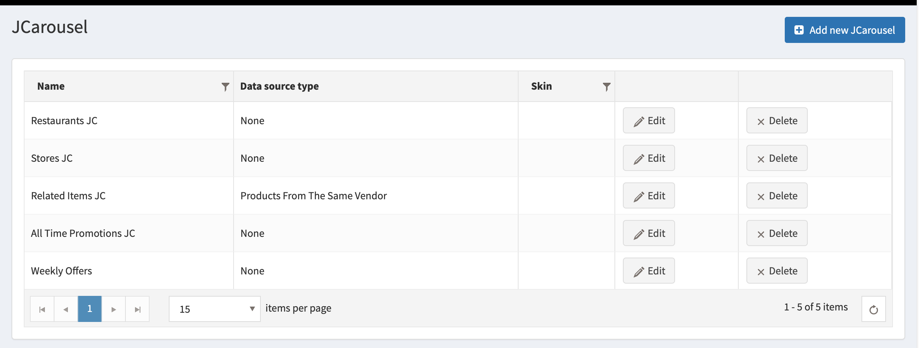
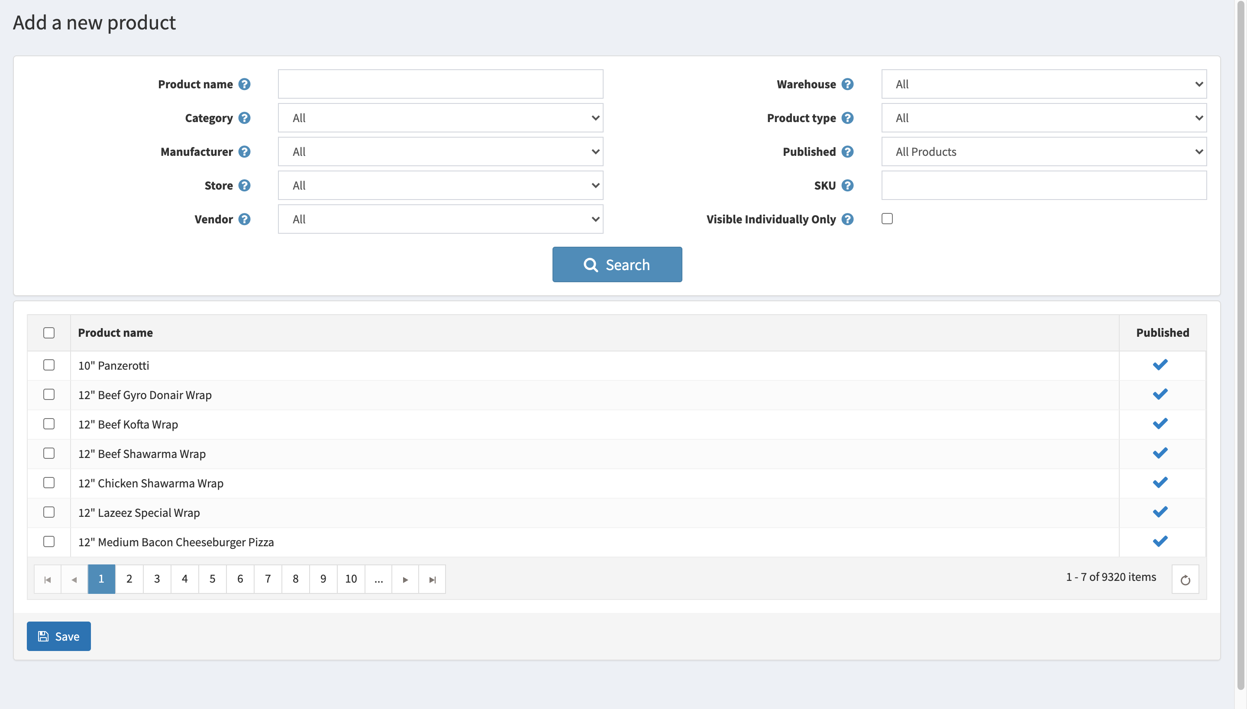
Comments
Scheduling
This is a separate page and its name is “Scheduling”. This can schedule Products availability as well as customer schedule. There are two tabs at the top.
The grid shows Name, Availability Time and Published checkout.
Once a schedule applied, the ”disable buy button” or “Delivery enabled” in the “catalog >> products >> product edit” page will be unchecked during the availability time and remained checked all other time. Time zone is defined in “Configuration >> Settings >> Customer Settings >> Default store time zone”.
Schedules will be visible to customers based on their roles. Admin can see all the schedules whereas Customers can see only their own schedules.
Catalog Schedule
Customer Schedule
schedule
Availability time
Published
Schedule for pizza hut morning
[8:00 AM to 12:00 PM; 7/8/2020 - 8/8/2020; All Days]
Schedule for Pizza Hut weekend
[10:00 AM to 1:00 PM; All Dates; Saturday, Sunday]
Schedule for McCafe Special
[1:00 PM to 4:00 PM; All Dates; All Days];
[6:00 PM to 10:00 PM; All Dates; Saturday, Sunday]
Schedule for Pizza Pizza special offer
[11:00 AM to 10:00 PM; All Dates; All Days]
Schedule for McCafe weekend night
[6:00 PM to 11:00 PM; 3/1/2020 – 8/31/2020; Saturday, Sunday]

Slide 5
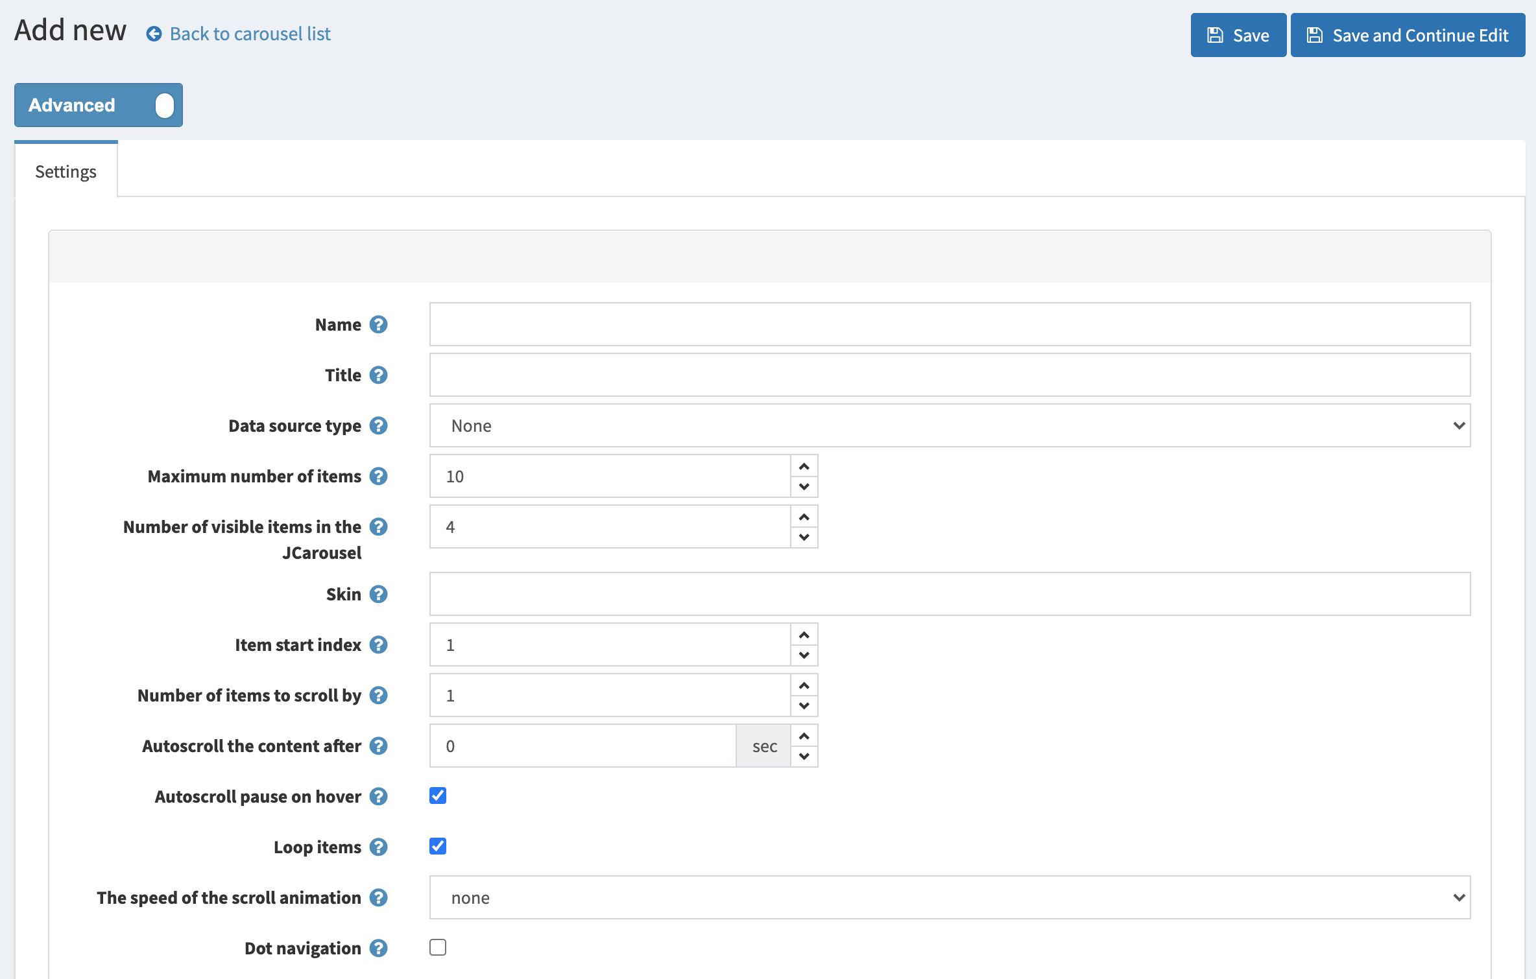

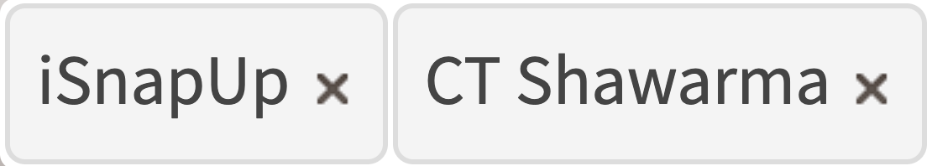

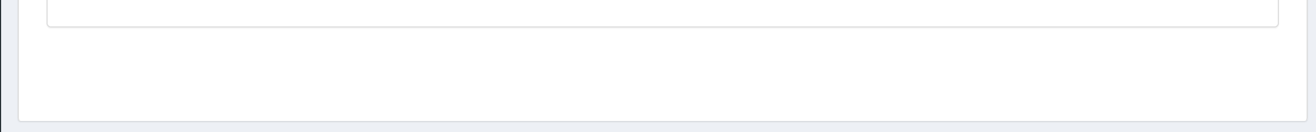
Add new Product Schedule
Comments
schedule
“Name” will be shown as in slide 2. “Limited to stores" or “Limited to warehouses” makes it applicable to only those stores that are selected here. Empty fields means applicable to all associated stores. Customers can see only those stores / warehouses that are associated to them.
There are two ways adopted to setup a scheduler:
1. Add Specific Dates: This tells availability of product(s) during the specified dates. For example “MM/DD/YY : hh:mm ”. When checkbox is checked, date fields will be visible. Empty date fields means applicable to all dates
2. Add Specific Days and Time: This option tells the availability of product(s) during specific days of a week (from Monday to Sunday) and specific hours of a day (see video how time fields should work).
Settings
Name:
Enter name of scheduler
Limited to stores:
Store1
Store2
Limited to warehouses:
Enter title of scheduler
Remove
Add Specific Dates:
✔️
Available Start date:
Available End date:
Add Specific Days and Time:
✔️
Start Time
End Time
✔️
Monday
9:00 AM
–
12:00 PM
–
2:00 PM
–
5:00 PM
–
+
✔️
Tuesday
6:00 PM
–
8:00 PM
–
+
✔️
Wednesday
–
–
+
Thursday
Friday
Saturday
Sunday
Add More Schedule
Disable buy button
Apply this schedule on:
✔️
✔️
Delivery enabled

Slide 6
Add new Product Schedule
Comments
schedule
When ”Add specific days and time” checkbox is not checked, it means the schedule is available for all days and all time.
Settings
Name:
Enter name of scheduler
Limited to stores:
Store1
Store2
Limited to warehouses:
Enter title of scheduler
Remove
Add Specific Dates:
✔️
Available Start date:
Available End date:
Add Specific Days and Time:
Add More Schedule
Disable buy button
Apply this schedule on:
✔️
✔️
Delivery enabled
“Disable buy button” and “Delivery Enabled” are two checkboxes present in each product. These checkboxes will be handled according to the checkboxes present in the product page.
Database table “SP_Schedule_Option” will have options ’1’ for Disable buy button and ‘2’ for Delivery enabled.

Slide 7
Add new Product Schedule
Comments
schedule
When ”Add specific days and time” checkbox is not checked, it means the product is available for all days and all time.
As the save button is clicked, two tabs will be displayed: Add Products and Add Categories
Only those products and categories will be shown that are mentioned in the limited to stores and warehouses.
Settings
Add Products
Add Categories
Add Manufacturer
Name:
Enter name of scheduler
Limited to stores:
Store1
Store2
Limited to warehouses:
Enter title of scheduler
Remove
Add Specific Dates:
✔️
Available Start date:
Available End date:
Add Specific Days and Time:
✔️
✔️
Monday
9:00 AM
–
12:35 PM
–
+
2:00 PM
–
5:00 PM
–
+
✔️
Tuesday
6:00 PM
–
8:00 PM
–
+
✔️
Wednesday
–
–
+
Thursday
Friday
Saturday
Sunday
Add More
Disable buy button
Apply this schedule on:
✔️
✔️
Delivery enabled

Slide 8

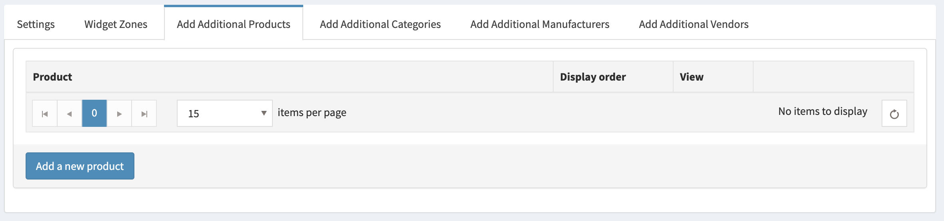
Add new Product Schedule
schedule
schedule
schedule
schedule
schedule
schedule
schedule
Comments
schedule
Once “Add Products” tab is clicked, admin will be able to add a new product by clicking on “Add a new product”. Only those products will be visible that are allowed to this type of admin and the filtration applied in the settings tab (limited to stores and limited to warehouses). For example, vendor will only see his own products and the ones that are mentioned in limited to the stores and warehouses.
Settings
Add Products
Add Categories
Add Manufacturer
SKU
Warehouse

Slide 9
Add new Product Schedule
schedule
schedule
schedule
Comments
schedule
schedule
“Add a new product” page has search options based on the admin type. Only main admin can see all options. The vendors can see “Product Name”, “Categories”, ”Manufacturer”, ”Product Type”, “Published” “SKU”, “Visible Individually Only”, related “Stores” and “Warehouses”.
Settings
Add Products
Add Categories
Add Vendors
Add Products
Add Categories
Add Manufacturer
SKU
Warehouse
SKU
Warehouse
sdaf342sd23
warehouse1
sdaf342sd23
warehouse1
sdaf342sd23
warehouse1
sdaf342sd23
warehouse1
sdaf342sd23
warehouse1
sdaf342sd23
warehouse1
sdaf342sd23
warehouse1

Slide 10
Add new Product Schedule
schedule
schedule
schedule
schedule
schedule
schedule
schedule
Comments
schedule
Once “Add Categories” tab is clicked, admin will be able to add new categories by clicking on “Add a new category”. Only those categories will be visible that are allowed to this type of admin and the filtration applied in the settings tab (limited to stores and limited to warehouses). For example, vendor will only see his own categories and the ones that are mentioned in limited to the stores and warehouses.
Settings
Add Products
Add Categories
Add Manufacturer
SKU
Warehouse
Category

Slide 11
Add new Product Schedule
schedule
schedule
schedule
Comments
schedule
schedule
“Add a new category” page has search options based on the admin type. Only main admin can see all options. The vendors can see “Categories, related “Stores” and “Warehouses”.
Settings
Add Products
Add Categories
Add Vendors
Add Products
Add Categories
Add Manufacturer
SKU
Warehouse
Category
Category
SKU
Warehouse
sdaf342sd23
warehouse1
sdaf342sd23
warehouse1
sdaf342sd23
warehouse1
sdaf342sd23
warehouse1
sdaf342sd23
warehouse1
sdaf342sd23
warehouse1
sdaf342sd23
warehouse1

Slide 12
Add new Product Schedule
schedule
schedule
schedule
schedule
schedule
schedule
schedule
Comments
schedule
Same as categories
Settings
Add Products
Add Categories
Add Manufacturer
SKU
Warehouse
Category

Slide 13
Add new Product Schedule
schedule
schedule
schedule
Comments
schedule
schedule
Same as categories
Settings
Add Products
Add Categories
Add Vendors
Add Products
Add Categories
Add Manufacturer
SKU
Warehouse
Category
Manufacturer
SKU
Warehouse
sdaf342sd23
warehouse1
sdaf342sd23
warehouse1
sdaf342sd23
warehouse1
sdaf342sd23
warehouse1
sdaf342sd23
warehouse1
sdaf342sd23
warehouse1
sdaf342sd23
warehouse1

Slide 14
Customer Schedule

Slide 15
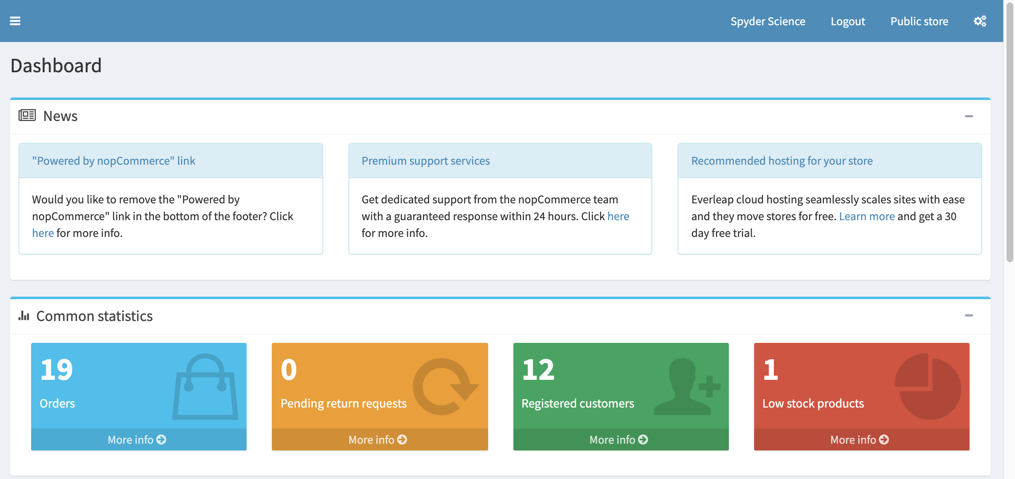
There will be an on / off button on the admin header. This is visible to each customer who has access to admin area. For vendors, this button will check the checkbox in the product edit page for “disable buy button” when it is off. And uncheck the checkbox when it is on.
This option will be used in the next slides for customer scheduling.
off
on

Slide 16
Comments
Scheduling
Catalog Schedule
Customer Schedule
This grid is similar to “Catalog Schedule” grid.
Schedules will be visible to customers based on their roles. Admin can see all the schedules whereas Vendors can see only their own schedules. Other customer roles cannot see product schedules but can see customer schedule for himself.
schedule
Availability time
Published
Customer 1 Name
[8:00 AM to 12:00 PM; 7/8/2020 - 8/8/2020; All Days]
Checkbox
Customer 2 Name
[10:00 AM to 1:00 PM; All Dates; Saturday, Sunday]
Checkbox
Customer 3 Name
[1:00 PM to 4:00 PM; All Dates; All Days];
[6:00 PM to 10:00 PM; All Dates; Saturday, Sunday]
Checkbox
Customer 4 Name
[11:00 AM to 10:00 PM; All Dates; All Days]
Checkbox
Customer 4 Name
[6:00 PM to 11:00 PM; 3/1/2020 – 8/31/2020; Saturday, Sunday]
Checkbox

Slide 17
Add new Customer Schedule
Comments
schedule
Settings
This is similar to “Add a new schedule” in “Catalog Schedule” grid.
“Limited to warehouses” option is hidden.
Name:
Enter name of scheduler
Limited to stores:
Store1
Store2
Remove
Add Specific Dates:
✔️
Available Start date:
Available End date:
Add Specific Days and Time:
✔️
✔️
Monday
9:00 AM
–
12:35 PM
–
+
2:00 PM
–
5:00 PM
–
+
✔️
Tuesday
6:00 PM
–
8:00 PM
–
+
✔️
Wednesday
–
–
+
Thursday
Friday
Saturday
Sunday
Add More

Slide 18
Add new Product Schedule
Comments
schedule
Settings
Add Customer
Once the save button is pressed, “Add customer” tab will be displayed. Customers that has access to see multiple customers, he will be able to see this tab.
For example, vendor will not see this tab because he cannot administer other customers.
Name:
Enter name of scheduler
Limited to stores:
Store1
Store2
Remove
Add Specific Dates:
✔️
Available Start date:
Available End date:
Add Specific Days and Time:
✔️
✔️
Monday
9:00 AM
–
12:35 PM
–
+
2:00 PM
–
5:00 PM
–
+
✔️
Tuesday
6:00 PM
–
8:00 PM
–
+
✔️
Wednesday
–
–
+
Thursday
Friday
Saturday
Sunday
Add More

Slide 19
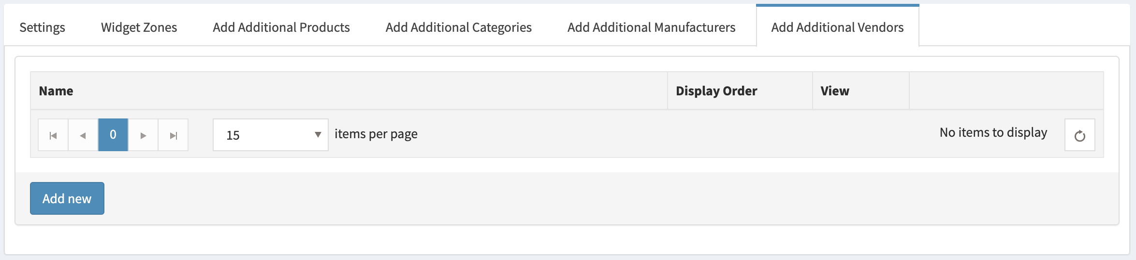
Add new Customer Schedule
schedule
schedule
Comments
schedule
schedule
Once “Add Customer” tab is clicked, admin will be able to add a new customer. Only those customers will be visible that are allowed to this customer.
Settings
Add Customer
SKU
Warehouse

Slide 20
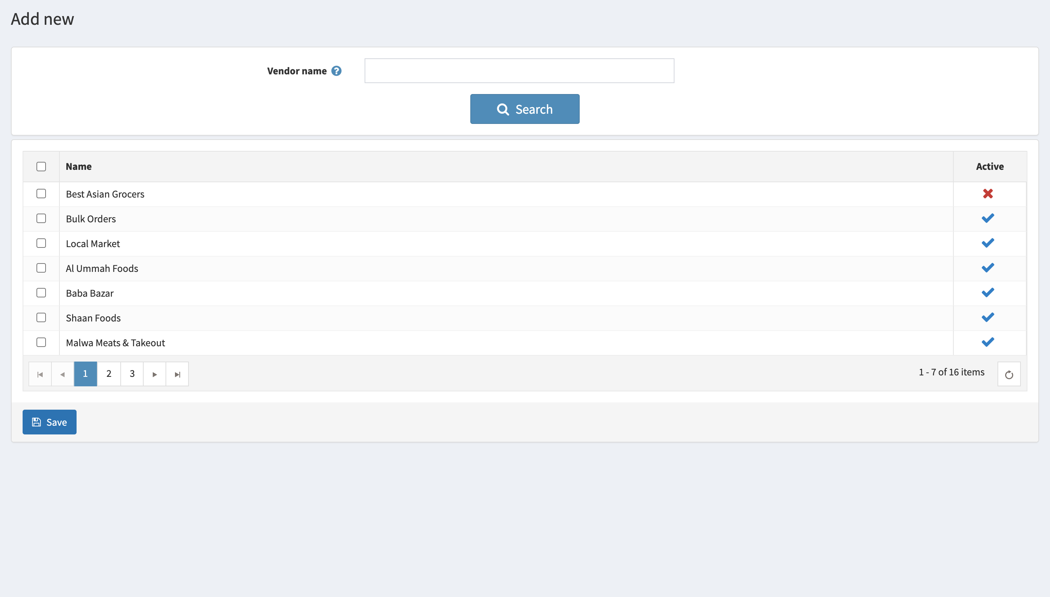
Add new Customer Schedule
schedule
schedule
Comments
schedule
schedule
The add new page will filter customers based on their name and customer roles.
Settings
Add Customer
SKU
Warehouse
Customer name
customer role:
Customer, Vendor

Slide 21
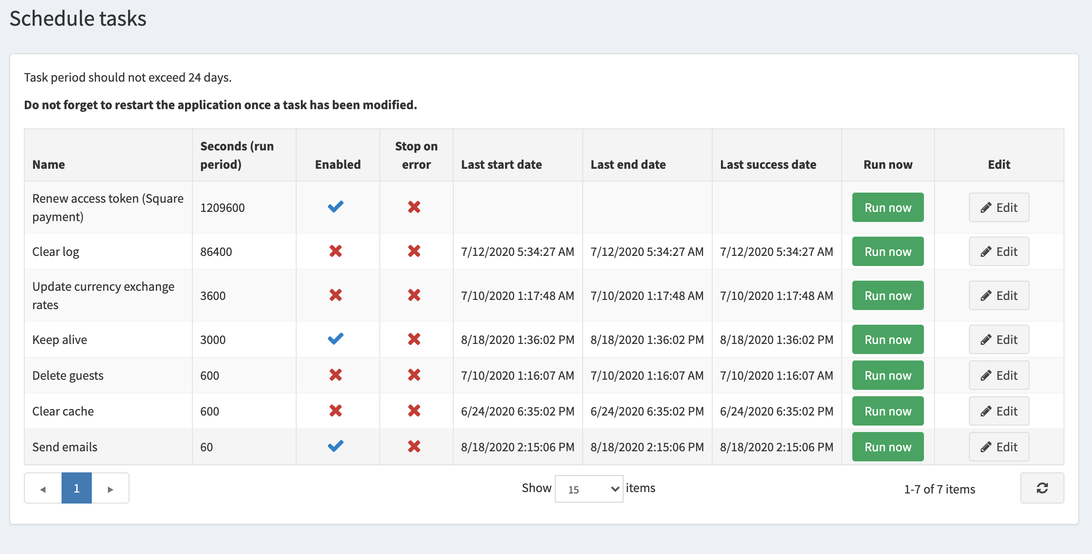
There will be an addition for scheduler in the list below. The schedules that are published in Catalog schedule tab (slide 4) and Customer schedule tab (slide 16) would be revised on the basis of seconds defined in the Schedule task. Once it is run after specific time, only those schedules will be revised (from slide 4 and slide 16) that are updated after the last execution of scheduler. Also the ones that were stopped due to an error will also try to get updated.

